Slide 1
Memory Hierarchy

Slide 2
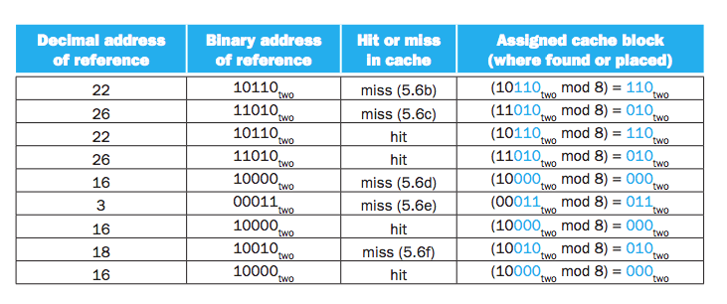
Accessing a Cache

Slide 3
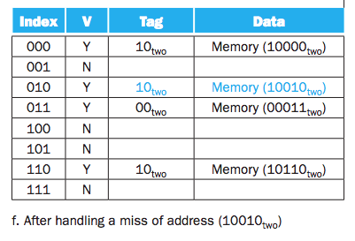
Accessing a Cache

Slide 4
Spec of Memory Address
To uniquely identify a word address
Index + tag code
Data existence
Valid bit

Slide 5
Bits Needed for a cache
Ia function of
Cache size
Address size

Slide 6
Tag, total bits
Consider the scenario
32 bit address
A direct-map cache
Cache size is 2^{n} blocks, n bit for index
The block size is 2^{m} words, m bits are for words with in block
2 bits are byte part
Tag = 32 – (m + n + 2)
Total bits = 2^{n} * (block size + tag + valid field size)

Slide 7
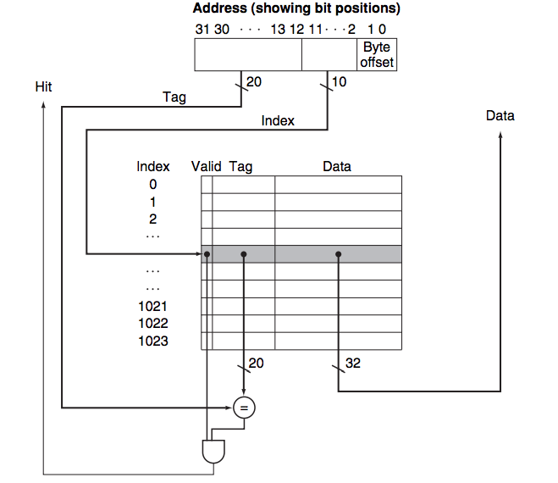
Reference address

Slide 8
Tag, total bits
Tag = 32 – (m + n + 2)
Total bits = 2^{n} * (block size + tag + valid field size)
The naming convention is to exclude tag and valid bit

Slide 9
Humber of bits
How many total bits are required for a direct-mapped cache with 16 KiB of data and 4-word blocks, assuming a 32-bit address?
4 words = 2²
16 KiB = 16 * 2¹⁰
= (16 * 8 )/32 * 2¹⁰
= 2¹² words
Each block has = 4 * 32 = 128 bits of data
Notes:
1024 word = 1024 * 32 bits = 1024 * 32/8 = 1024 * 4 KiB (killobytes)
16 * 1024 = 16 * 8 * 1024 = (16*8)/32 * 1024 = 2² * 2¹⁰ = 2¹²

Slide 10
Humber of bits
How many total bits are required for a direct-mapped cache with 16 KiB of data and 4-word blocks, assuming a 32-bit address?
Tag = 32 - 10 - 2 – 2
Total bits = 2¹⁰ * (2² * 32 + 18 + 1)
= 1024 * (4 * 32 + 19)
= 1024 * 147
= 147 Kibibits
= 18.4 KiB (8 bits = 1 Byte)
Notes:
1024 word = 1024 * 32 bits = 1024 * 32/8 = 1024 * 4 KiB (killobytes)
16 * 1024 = 16 * 8 * 1024 = (16*8)/32 * 1024 = 2² * 2¹⁰ = 2¹²

Slide 11
Mapping Address to Multi Word Cache Block
Consider a cache with 64 blocks and a block size of 16 bytes. To what block number does byte address 1200 map?
Answer:
The block number =
(Block address) modulo (Number of blocks in the cache)

Slide 12
Mapping Address to Multi Word Cache Block
Block address = byte address / block size
= 1200/16
= 75
Block number = 75 modulo 64 = 11
1200 to 1215 will go to block number 11

Slide 13
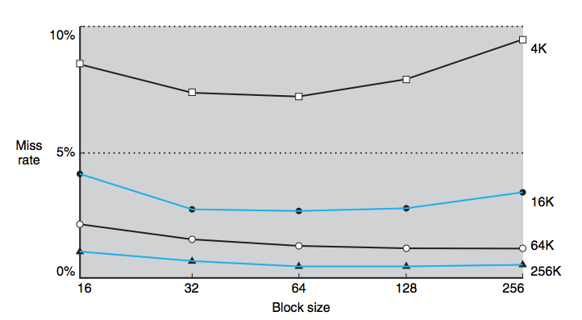
Larger blocks exploit spatial locality

Slide 14
Miss Rate VS Block Size.
Increase the block size decrease the miss rate
Miss rate may go up if block size becomes a significant factor of cache size
Number of blocks will become small
Would be bumped before use
Miss penalty will increase

Slide 15
Larger blocks exploit spatial locality

Slide 16
Cache Misses
On cache hit
CPU proceeds normally;
on cache miss
Stall the CPU pipeline
Fetch block from next level of hierarchy
Instruction cache miss: restart instruction fetch
Data cache miss: complete data access

Slide 17
Handling Writes
On data-write hit, could just update the block in cache
But then cache and memory would be inconsistent
Write through: also update memory
But makes writes take longer, e.g. if base CPI = 1, 10% of instructions are stores, write to memory take 100 cycles: effective CPI = 1 + 0.1×100 = 11
Solution: write buffer
Holds data waiting to be written to memory
CPU continues immediately, only stalls on write if write buffer is already full

Slide 18
Handling Writes
Solution: write buffer
Holds data waiting to be written to memory
CPU continues immediately, only stalls on write if write buffer is already full
Write back alternative: On data-write hit, just update the block in cache
Keep track of whether each block is dirty
When a dirty block is replaced, write it back to memory

Slide 19
Covered
Section 5.3

